Slide 1
Chapter 9:
Analysis of next-generation sequence data
Jonathan Pevsner, Ph.D.
pevsner@kennedykrieger.org
Bioinformatics and Functional Genomics
(Wiley-Liss, 3rd edition, 2015)
You may use this PowerPoint for teaching purposes

Slide 2
Learning objectives
After studying this chapter you should be able to:
explain how sequencing technologies generate NGS data;
describe the FASTQ, SAM/BAM, and VCF data formats;
compare methods for aligning NGS data to a reference genome;
describe types of genomic variants and how they are determined;
explain types of error associated with alignment, assembly, and variant calling; and
explain methods for predicting the functional consequence of genomic variants in individual genomes.

Slide 3
Outline:
Analysis of Next-Generation Sequence (NGS) Data
Introduction
DNA sequencing technologies
Sanger sequencing; NGS; Illumina; pyrosequencing; ABI SOLiD; Ion Torrent; Pac Bio; Complete Genomics
Analysis of NGS sequencing of genomic DNA
Overview Topic 6: Variant calling: SNVs
Topic 1: Design Topic 7: Variant calling: SVs
Topic 2: FASTQ Topic 8: VCF
Topic 3: Assembly Topic 9: Visualizing NGS data
Topic 4: Alignment Topic 10: Significance
Topic 5: SAM/BAM
Specialized applications of NGS
Perspective

Slide 4
Human genome sequencing
We currently obtain whole genome sequences at 30x to 50x depth of coverage. For a typical individual:
2.8 billion base pairs are sequenced
~3-4 million single nucleotide variants
~600,000 insertions/deletions (indels)
Cost (research basis) is <$2000 per genome
We try to sequence mother/father/child trios

Slide 5
Human genome sequencing
We currently obtain whole genome sequences at 30x to 50x depth of coverage. For a typical individual:
2.8 billion base pairs are sequenced
~3-4 million single nucleotide variants
~600,000 insertions/deletions (SNPs)
Cost (research basis) is <$2000
We try to sequence mother/father/child trios
We also can enrich the collection of exons (“whole exome sequencing”). For a typical individual:
60 million base pairs are sequenced
There are ~80,000 variants
There are ~11,000 nonsynonymous SNPs

Slide 6
Outline:
Analysis of Next-Generation Sequence (NGS) Data
Introduction
DNA sequencing technologies
Sanger sequencing; NGS; Illumina; pyrosequencing; ABI SOLiD; Ion Torrent; Pac Bio; Complete Genomics
Analysis of NGS sequencing of genomic DNA
Overview Topic 6: Variant calling: SNVs
Topic 1: Design Topic 7: Variant calling: SVs
Topic 2: FASTQ Topic 8: VCF
Topic 3: Assembly Topic 9: Visualizing NGS data
Topic 4: Alignment Topic 10: Significance
Topic 5: SAM/BAM
Specialized applications of NGS
Perspective

Slide 7
Sanger sequencing: what we had before NGS
Introduced in 1977
A template is denatured to form single strands, and extended with a polymerase in the presence of dideoxynucleotides (ddNTPs) that cause chain termination.
Typical read lengths are up to 800 base pairs. For the sequencing of Craig Venter’s genome (2007; first whole genome of an individual), Sanger sequencing was employed because of its relatively long read lengths.

Slide 8
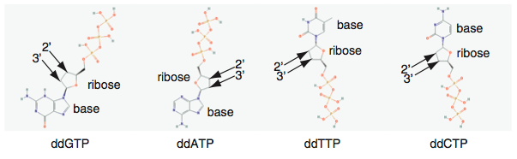
DNA sequencing by the Sanger method
Dideoxynucleotides (ddNTPs)( -OH of dNTP is replaced by -H of ddNTP at the 2’ ribose position)
B&FG 3e
Fig.9-1
Page 380

Slide 9
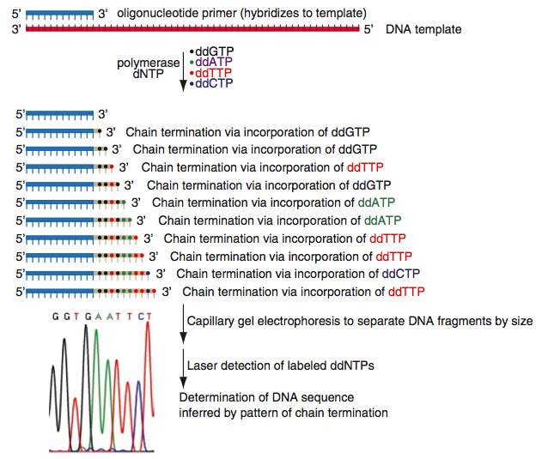
DNA sequencing by the Sanger method
Primer elongation, chain termination upon incorporation of ddNTP, separation, detection
B&FG 3e
Fig.9-1
Page 380

Slide 10
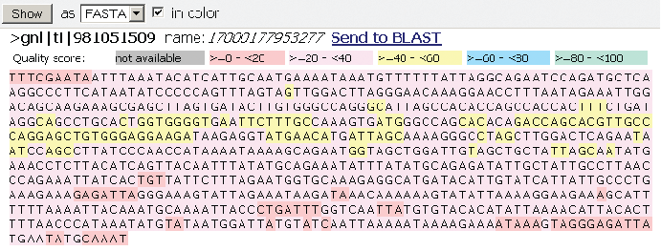
View genomic DNA (here from the beta globin locus) from the Trace Archive at NCBI: FASTA format
B&FG 3e
Fig.9-2
Page 381

Slide 11
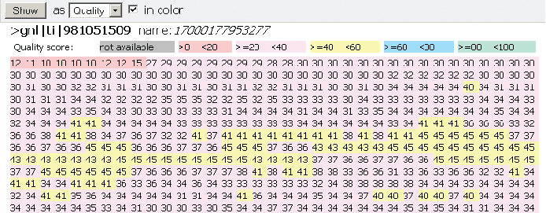
Each DNA base in the Trace Archive has an associated base quality score
(best scores highlighted in yellow)
B&FG 3e
Fig.9-2
Page 381

Slide 12
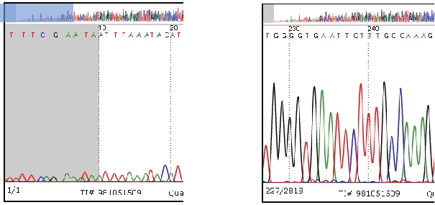
Examples of Sanger sequencing traces
Low quality reads
High quality reads
B&FG 3e
Fig.9-2
Page 381

Slide 13
Next-generation sequence technologies
Technology | Read length (bp) | Reads per run | Time per run | Cost per megabase | Accuracy
Roche 454 | 700 | 1 million | 1 day | $10 | 99.9%
Illumina | 50-250 | <3 billion | 1-10 days | ~$0.10 | 98%
SOLiD | 50 | ~1.4 billion | 7-14 days | $0.13 | 99.9%
Ion Torrent | 200 | <5 million | 2 hours | $1 | 98%
Pacific Biosciences | 2900 | <75,000 | <2 hours | $2 | 99%
Sanger | 400-900 | N/A | <3 hours | $2400 | 99.9%
Source: adapted from Wikipedia 1/11/13

Slide 14
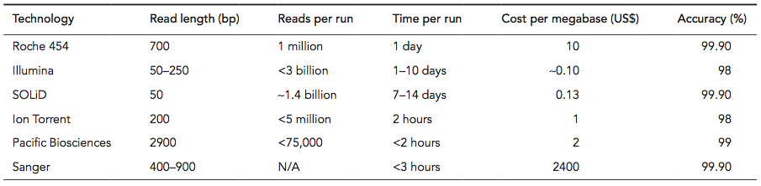
NGS technologies compared to Sanger sequencing
B&FG 3e
Table 9-1
Page 382

Slide 15
Whole genome sequencing (WGS) costs
have declined dramatically
B&FG 3e
Fig.9-3
Page 383

Slide 16
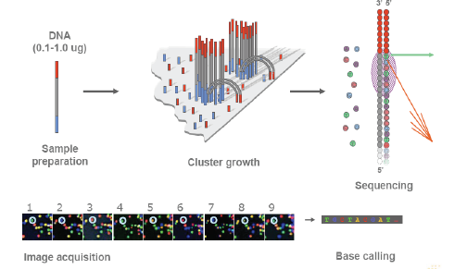
Next-generation sequence technology: Illumina

Slide 17
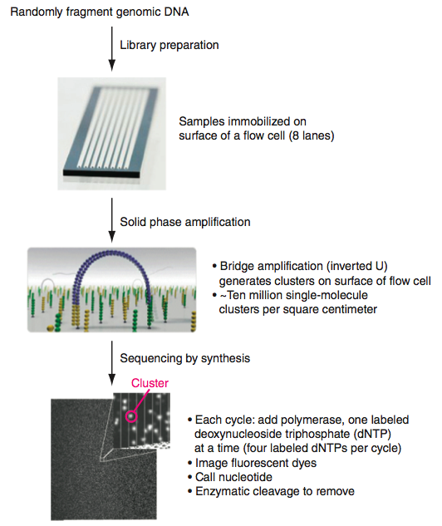
Sequencing by Illumina technology
B&FG 3e
Fig.9-4
Page 384

Slide 18
Cycle termination sequencing (Illumina)
Disadvantage:
Short read length (~150 bases)
Advantages:
Very fast
Low cost per base
Large throughput; up to 1 gigabase/epxeriment
Short read length makes it appropriate for resequencing
No need for gel electrophoresis
High accuracy
All four bases are present at each cycle, with sequential addition of dNTPs. This allows homopolymers to be accurately read.

Slide 19
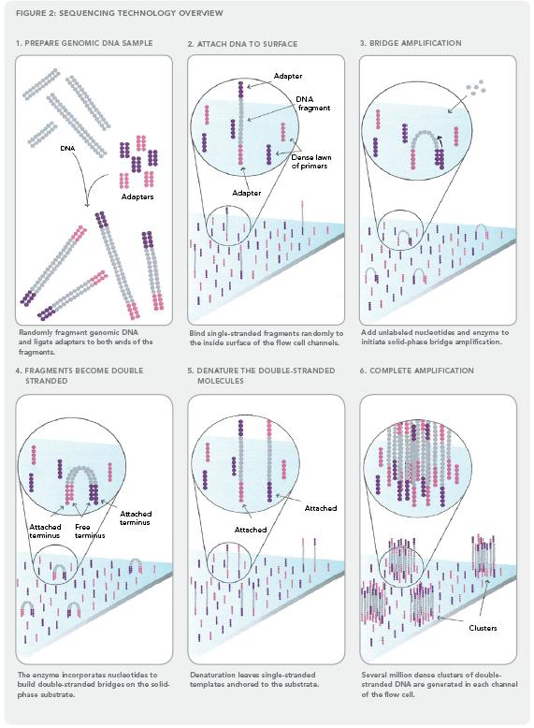
Illumina sequencing technology in 12 steps
Source: http://www.illumina.com/downloads/SS_DNAsequencing.pdf
Notes:
19

Slide 20
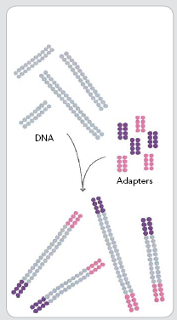
1. Prepare genomic DNA
2. Attach DNA to surface
3. Bridge amplification
4. Fragments become double stranded
5. Denature the double- stranded molecules
6. Complete amplification
DNA
adapters
Randomly fragment genomic DNA and ligate adapters to both ends of the fragments

Slide 21

adapter
DNA fragment
1. Prepare genomic DNA
2. Attach DNA to surface
3. Bridge amplification
4. Fragments become double stranded
5. Denature the double- stranded molecules
6. Complete amplification
dense lawn of primers
adapter
Bind single-stranded fragments randomly to the inside surface of the flow cell channels

Slide 22
1. Prepare genomic DNA
2. Attach DNA to surface
3. Bridge amplification
4. Fragments become double stranded
5. Denature the double- stranded molecules
6. Complete amplification
Add unlabeled nucleotides and enzyme to initiate solid-phase bridge amplification

Slide 23
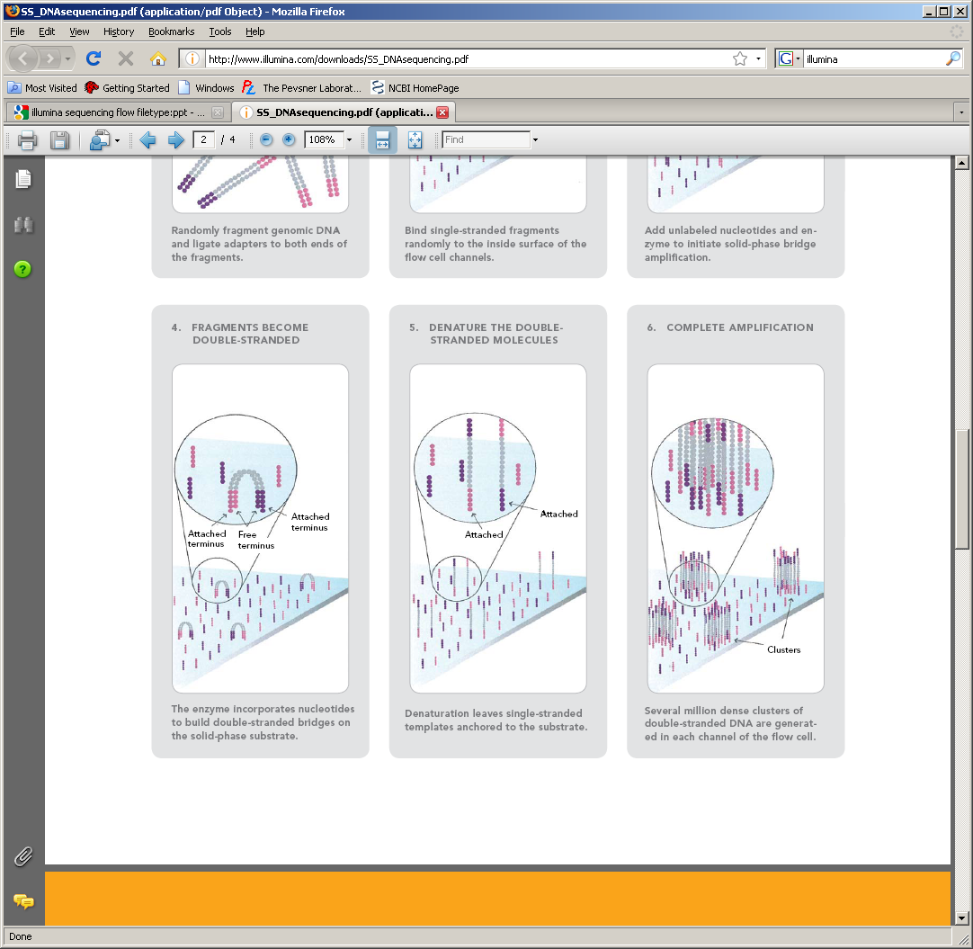
1. Prepare genomic DNA
2. Attach DNA to surface
3. Bridge amplification
4. Fragments become double stranded
5. Denature the double- stranded molecules
6. Complete amplification
Attached
terminus
Attached terminus
free
terminus
The enzyme incorporates nucleotides to build double-stranded bridges on the solid-phase substrate

Slide 24
1. Prepare genomic DNA
2. Attach DNA to surface
3. Bridge amplification
4. Fragments become double stranded
5. Denature the double- stranded molecules
6. Complete amplification
Attached
Attached
Denaturation leaves single-stranded templates anchored to the substrate

Slide 25
1. Prepare genomic DNA
2. Attach DNA to surface
3. Bridge amplification
4. Fragments become double stranded
5. Denature the double- stranded molecules
6. Complete amplification
Clusters
Several million dense clusters of double-stranded DNA are generated in each channel of the flow cell

Slide 26
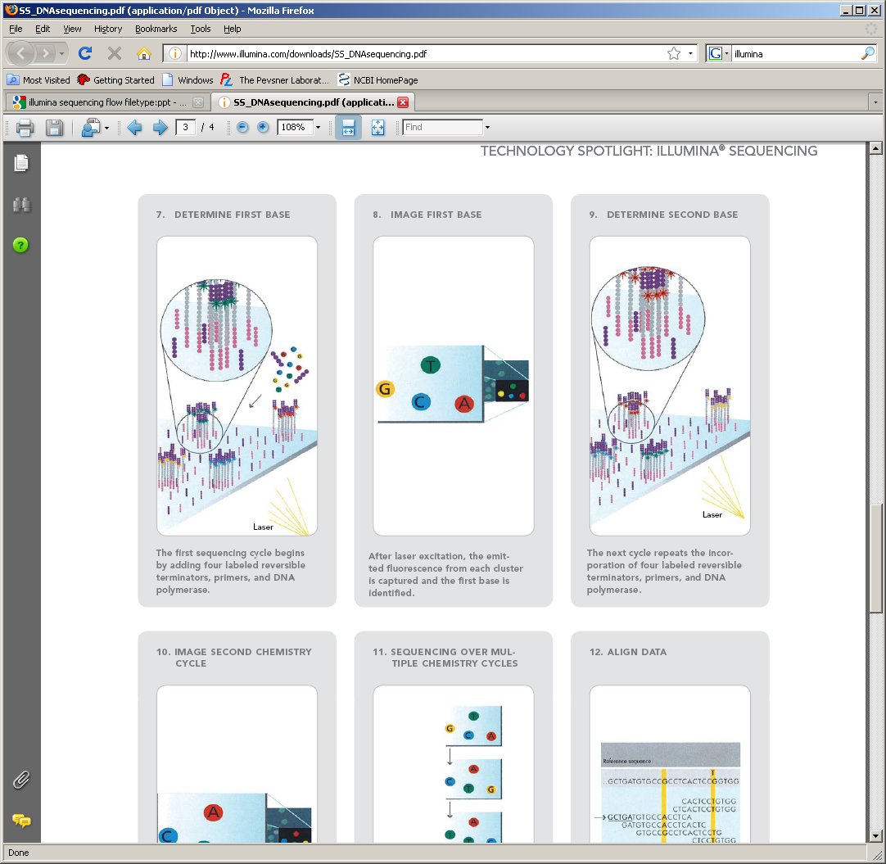
7. Determine first base
8. Image first base
9. Determine second base
10. Image second chemistry cycle
11. Sequencing over multiple chemistry cycles
12. Align data
Laser
The first sequencing cycle begins by adding four labeled reversible terminators, primers, and DNA polymerase

Slide 27
7. Determine first base
8. Image first base
9. Determine second base
10. Image second chemistry cycle
11. Sequencing over multiple chemistry cycles
12. Align data
After laser excitation, the emitted fluorescence from each cluster is captured and the first base is identified

Slide 28
7. Determine first base
8. Image first base
9. Determine second base
10. Image second chemistry cycle
11. Sequencing over multiple chemistry cycles
12. Align data
Laser
The next cycle repeats the incorporation of four labeled reversible terminators, primers, and DNA polymerase

Slide 29
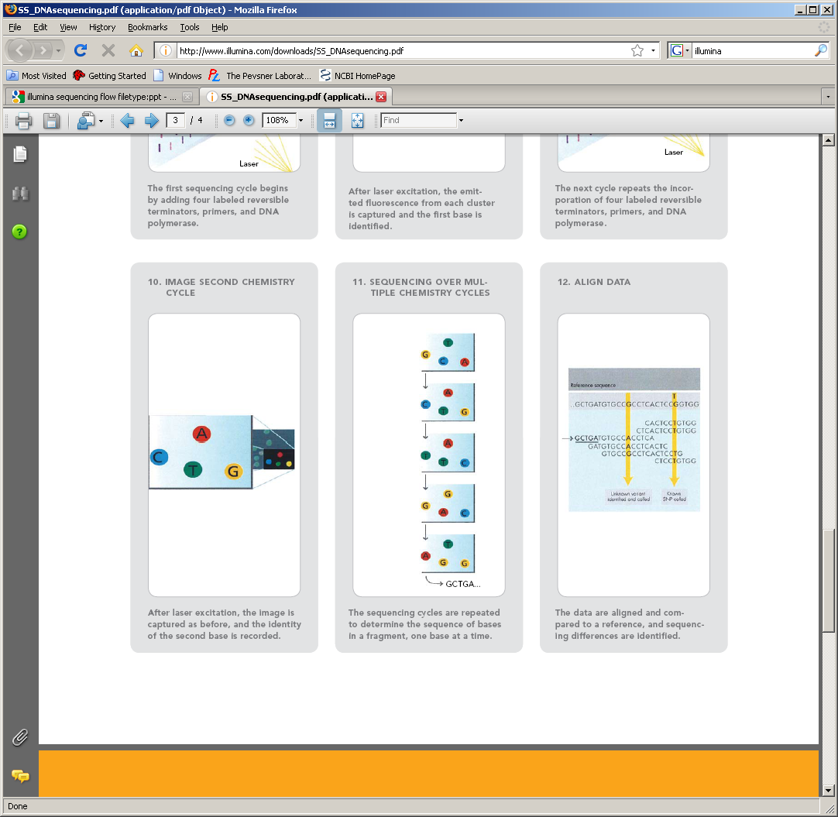
7. Determine first base
8. Image first base
9. Determine second base
10. Image second chemistry cycle
11. Sequencing over multiple chemistry cycles
12. Align data
After laser excitation the image is captured as before, and the identity of the second base is recorded.

Slide 30
7. Determine first base
8. Image first base
9. Determine second base
10. Image second chemistry cycle
11. Sequencing over multiple chemistry cycles
12. Align data
The sequencing cycles are repeated to determine the sequence of bases in a fragment, one base at a time.

Slide 31
Reference sequence
7. Determine first base
8. Image first base
9. Determine second base
10. Image second chemistry cycle
11. Sequencing over multiple chemistry cycles
12. Align data
Unknown variant identified and called
Known SNP called
The data are aligned and compared to a reference, and sequencing differences are identified.

Slide 32
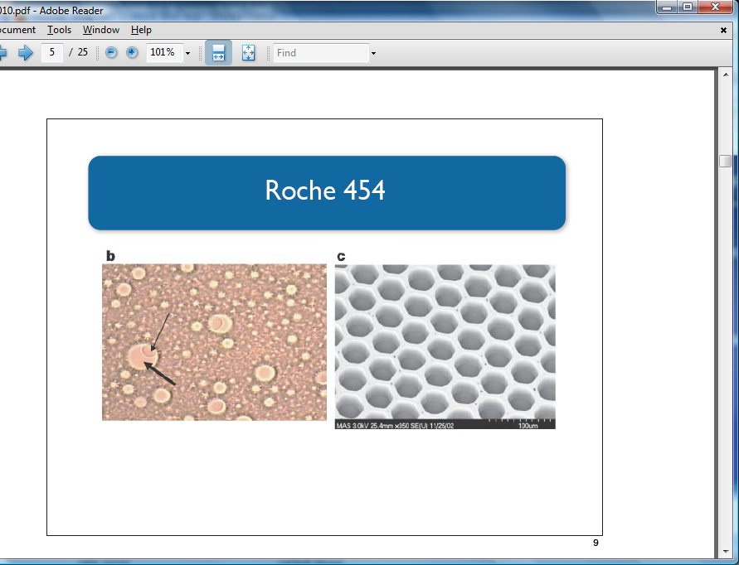
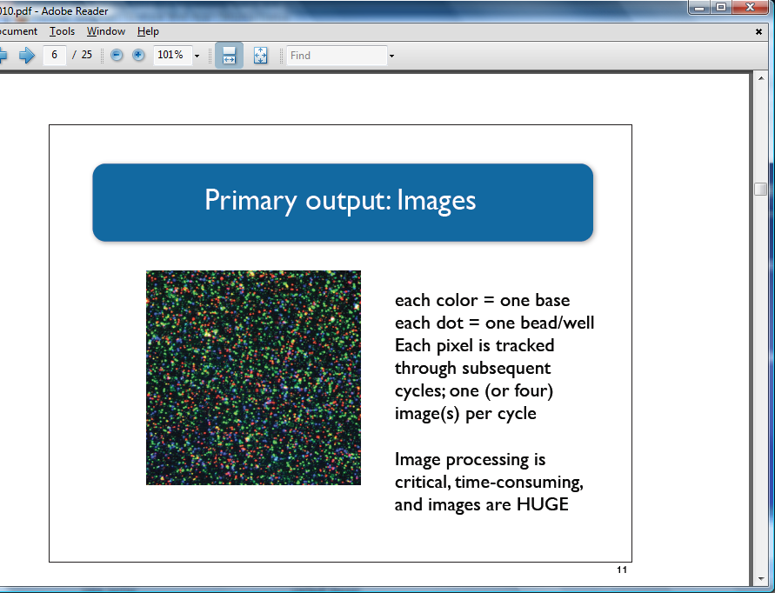
NGS technologies: Roche 454
Introduced in 2005 (sequenced Mycoplasma genitalium genome in one run)
~2400 publications (as of Jan. 2013) but now defunct
Sequencing by synthesis: nucleotide incorporation leads to light emission
Notes:
32

Slide 33
Pyrosequencing
Advantages:
Very fast
Low cost per base
Large throughput; up to 40 megabases/epxeriment
No need for bacterial cloning (with its associated artifacts); this is especially helpful in metagenomics
High accuracy
Disadvantages:
Short read lengths (soon to be extended to ~500 bp)
Difficulty sequencing homopolymers accurately

Slide 34
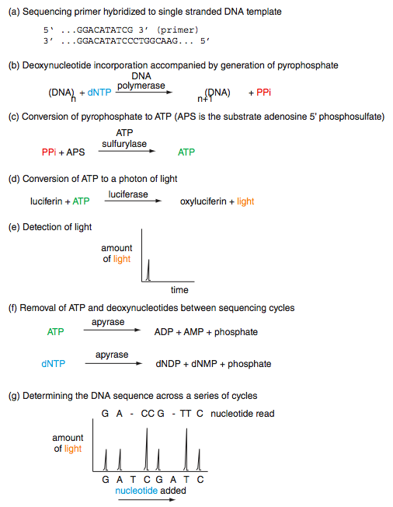
Pyrosequencing
B&FG 3e
Fig.9-5
Page 386

Slide 35
Outline:
Analysis of Next-Generation Sequence (NGS) Data
Introduction
DNA sequencing technologies
Sanger sequencing; NGS; Illumina; pyrosequencing; ABI SOLiD; Ion Torrent; Pac Bio; Complete Genomics
Analysis of NGS sequencing of genomic DNA
Overview Topic 6: Variant calling: SNVs
Topic 1: Design Topic 7: Variant calling: SVs
Topic 2: FASTQ Topic 8: VCF
Topic 3: Assembly Topic 9: Visualizing NGS data
Topic 4: Alignment Topic 10: Significance
Topic 5: SAM/BAM
Specialized applications of NGS
Perspective

Slide 36
A workflow for whole genome sequencing (WGS)
of individual genomes
1. Select proband(s)
2. Purify genomic DNA
3. Generate paired-end library
4. Design capture beads (e.g. Agilent SureSelect)
5. Hybridize in solution
6. Elute enriched genomic DNA
7. Amplify
8. Next-generation sequencing
9. Align sequence to a human genome reference
10. Determine coverage (e.g. 30-fold)
11. Identify variants: SNPs, indels (distinguish true variants from sequencing errors)
12. Prioritize variants
13. Validate variants
optional; used for whole exome sequencing
Notes:
36

Slide 37
Broad clinical workflow for WGS of patients
Overview of the process
Motivation to sequence a patient’s genome
Oversight, IRB, and informed consent
Time frame and costs
Inclusion criteria: identifying appropriate patients
Exclusion criteria: whose genome not to sequence
Data acquisition
Informed consent, blood, and saliva
Obtaining whole genome sequence: the technology
The deliverables: catalogs of genetic variants
Data interpretation
Identifying candidate genes
Validation

Slide 38
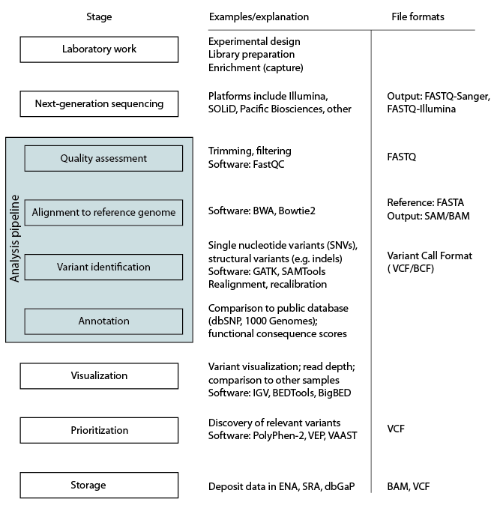
Next-generation sequencing workflow
B&FG 3e
Fig.9-6
Page 388

Slide 39
Genome Analysis Toolkit (GATK) workflow
Phase I: data processing
B&FG 3e
Fig.9-7
Page 389

Slide 40
Genome Analysis Toolkit (GATK) workflow
Phase II: variant discovery and genotyping
B&FG 3e
Fig.9-7
Page 389

Slide 41
Genome Analysis Toolkit (GATK) workflow
Phase III: integrative analysis
B&FG 3e
Fig.9-7
Page 389

Slide 42
Outline:
Analysis of Next-Generation Sequence (NGS) Data
Introduction
DNA sequencing technologies
Sanger sequencing; NGS; Illumina; pyrosequencing; ABI SOLiD; Ion Torrent; Pac Bio; Complete Genomics
Analysis of NGS sequencing of genomic DNA
Overview Topic 6: Variant calling: SNVs
Topic 1: Design Topic 7: Variant calling: SVs
Topic 2: FASTQ Topic 8: VCF
Topic 3: Assembly Topic 9: Visualizing NGS data
Topic 4: Alignment Topic 10: Significance
Topic 5: SAM/BAM
Specialized applications of NGS
Perspective

Slide 43
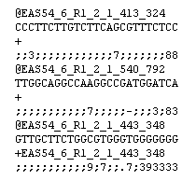
FASTQ format
The FASTQ format stores DNA sequence data as well as associated Phred quality scores of each base.
DNA read
Base quality score
Notes:
43

Slide 44
FASTQ quality scores use ASCII characters
…relating quality scores (e.g. Q30 for 1 in 10⁻³ error rate) to a compact, one character symbol
B&FG 3e
Fig.9-8
Page 392
You do not need to learn the one character symbols, but you should know the importance of base quality scores in sequence analysis.

Slide 45
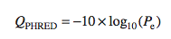
FASTQ format: Phred scores define quality
The FASTQ format stores DNA sequence data as well as associated Phred quality scores of each base.
Phred quality score | Probability of incorrect base call | Base call accuracy
10 | 1 in 10 | 90%
20 | 1 in 100 | 99%
30 | 1 in 1,000 | 99.9%
40 | 1 in 10,000 | 99.99%
50 | 1 in 100,000 | 99.999%
Notes:
45

Slide 46
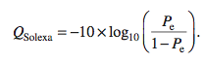
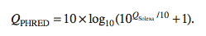
FASTQ format: Phred scores define quality
Phred quality scores of each base are usually defined:
There have been alternative base quality definitions:
B&FG 3e
Page 391
Notes:
46

Slide 47
99% of sequence analysis is on the command line
(Linux or Mac)
Most next-generation sequence (NGS) analysis is done on the command line. Command line software (using Linux or the Unix-like platform on a Mac terminal) is capable of handling the data analysis tasks, and most NGS software is written for the Unix operating system.
Many people access a Linux (or related Unix) environment while working on a PC or Mac. For example, you can do “cloud computing” in which you pay someone (Amazon, Google, Microsoft) to access their servers. Johns Hopkins has Linux servers you can access (https://www.marcc.jhu.edu).
The next three slides provide examples of command-line tools to look at FASTQ-formatted files.

Slide 48
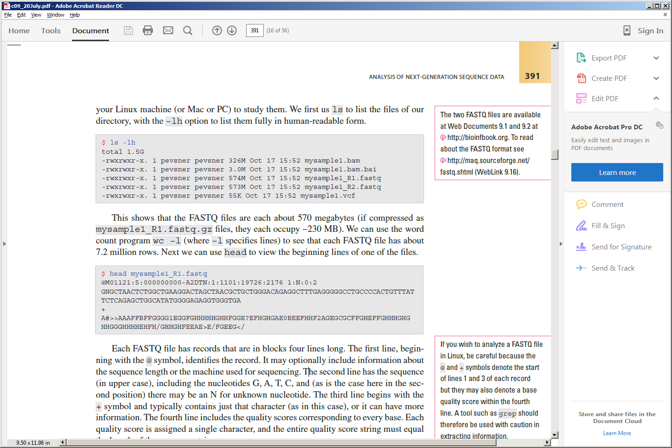
99% of sequence analysis is on the command line
(Linux or Mac)
The ls –lh command lists the files in a directory.
Here there are two FASTQ files, BAM, BAM index, and VCF.
The head command displays the first few lines of a file. Here the first four rows of a FASTQ file are shown.
B&FG 3e
Page 391

Slide 49
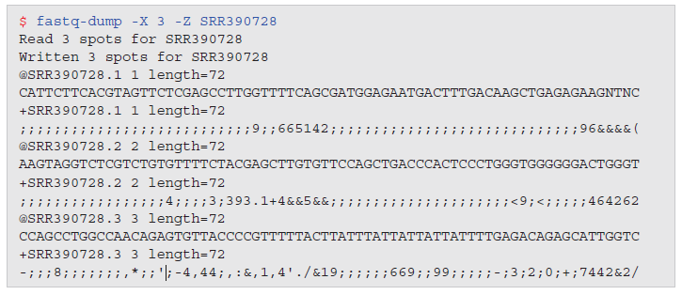
SRA toolkit:
fastq-dump to obtain FASTQ formatted data
NCBI offers the SRA Toolkit to manipulate sequence data. The fastq-dump command can pull FASTQ-formatted data from an accession number (such as SRR390728).
B&FG 3e
Page 393

Slide 50
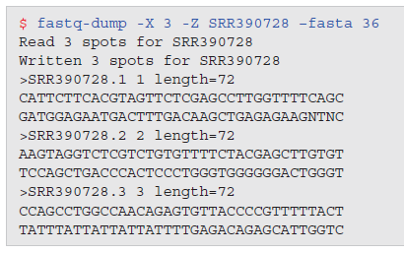
SRA toolkit:
fastq-dump to obtain FASTA formatted data
B&FG 3e
Page 393

Slide 51
Finding FASTQ files
There are two main places you can find FASTQ files.
The central repositories at NCBI and EBI
A sequencing core: data are often returned to investigators in the FASTQ format. (In some cases the data are returned in the BAM format, discussed next, from which FASTQ-formatted data can be retrieved.)

Slide 52
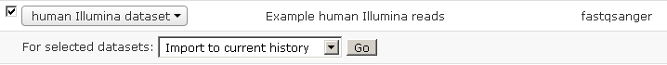
FASTQ format: where to learn more
FASTQ project page http://maq.sourceforge.net/fastq.shtml
You can look at FASTQ files in Galaxy > Shared data > Data libraries > Sample NGS Datasets > Human Illumina dataset. Check the box, click Go, and the data are entered in Galaxy (see the Analyze Data tab where you usually begin a Galaxy session).
Galaxy also offers helpful videocasts about manipulating FASTQ files.
Notes:
52

Slide 53
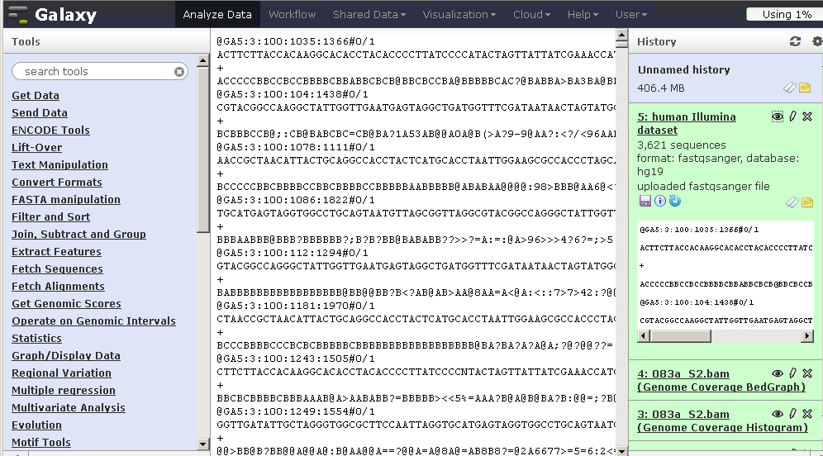
Example of FASTQ data in Galaxy

Slide 54
Outline:
Analysis of Next-Generation Sequence (NGS) Data
Introduction
DNA sequencing technologies
Sanger sequencing; NGS; Illumina; pyrosequencing; ABI SOLiD; Ion Torrent; Pac Bio; Complete Genomics
Analysis of NGS sequencing of genomic DNA
Overview Topic 6: Variant calling: SNVs
Topic 1: Design Topic 7: Variant calling: SVs
Topic 2: FASTQ Topic 8: VCF
Topic 3: Assembly Topic 9: Visualizing NGS data
Topic 4: Alignment Topic 10: Significance
Topic 5: SAM/BAM
Specialized applications of NGS
Perspective

Slide 55
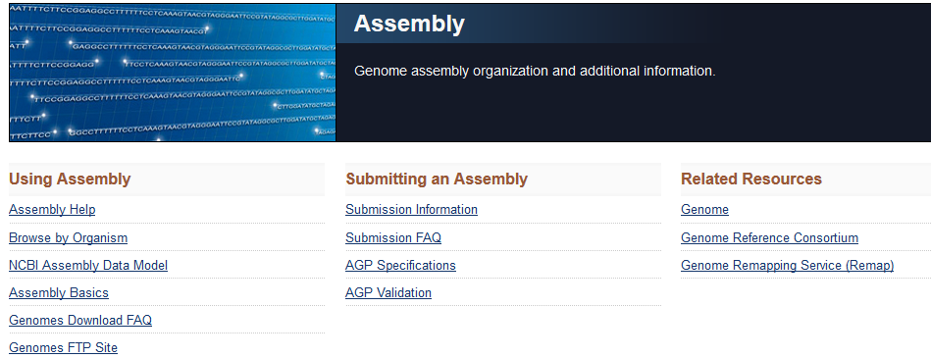
Genome assembly
Genome assembly is the process of converting short reads into a detailed set of sequences corresponding to the chromosome(s) of an organism.
To learn more about assembly visit
http://www.ncbi.nlm.nih.gov/assembly/
http://www.ncbi.nlm.nih.gov/assembly/basics/

Slide 56
Genome assembly: relevance
Genome assembly is needed when a genome is first sequenced. We can relate reads to chromosomes.
For the human genome, the assembly is “frozen” as a snapshot every few years. The current assembly is GRCh38. (GRC refers to Genome Reference Consortium at http://www.ncbi.nlm.nih.gov/projects/genome/assembly/grc/)
For most human genome work we do not need to do “de novo” (from anew) assembly. Instead we map reads to a reference genome—one that is already assembled.
Genome assembly is a crucial behind-the-scenes part of calling human genome (or other) variants.

Slide 57
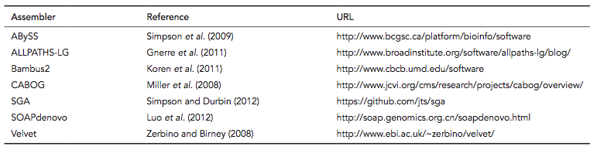
Software for genome assembly
B&FG 3e
Table 9-2
Page 395
We’ll use Velvet for assembly in Chapter 15.

Slide 58
Genome assembly methods:
overlap graph, de Bruijn graph, string graph
overlap graph
reads
de Bruijn graph
B&FG 3e
Fig.9-9
Page 396
string graph

Slide 59
Genome assembly with overlap graph
and de Bruijn graph
DNA sequence with a triple repeat
Layout graph
Construction of de Bruijn
graph by gluing repeats
de Bruijn graph
B&FG 3e
Fig.9-10
Page 397

Slide 60
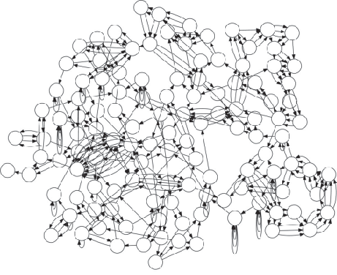
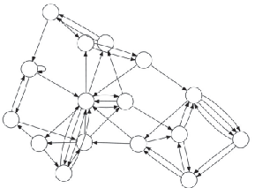

de Bruijn graphs resolve assembly with higher k values
E. coli K12 (k=50)
E. coli K12 (k=1,000)
E. coli K12 (k=5,000)
B&FG 3e
Fig.9-11
Page 398
Source: PMID 24034426

Slide 61
Outline:
Analysis of Next-Generation Sequence (NGS) Data
Introduction
DNA sequencing technologies
Sanger sequencing; NGS; Illumina; pyrosequencing; ABI SOLiD; Ion Torrent; Pac Bio; Complete Genomics
Analysis of NGS sequencing of genomic DNA
Overview Topic 6: Variant calling: SNVs
Topic 1: Design Topic 7: Variant calling: SVs
Topic 2: FASTQ Topic 8: VCF
Topic 3: Assembly Topic 9: Visualizing NGS data
Topic 4: Alignment Topic 10: Significance
Topic 5: SAM/BAM
Specialized applications of NGS
Perspective

Slide 62
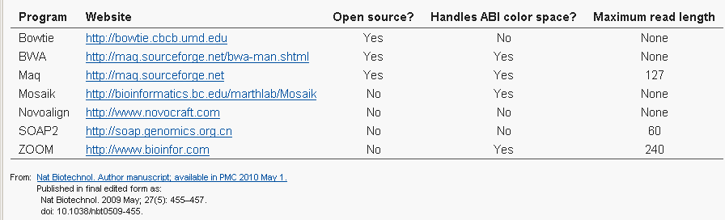
Next-generation sequence: the problem of alignment
Recent software tools allow the mapping (alignment) of millions or billions of short reads to a reference genome.
--For the human genome, this would take thousands of hours using BLAST.
--Reads may come from regions of repetitive DNA (exacerbated by sequencing errors)

Slide 63
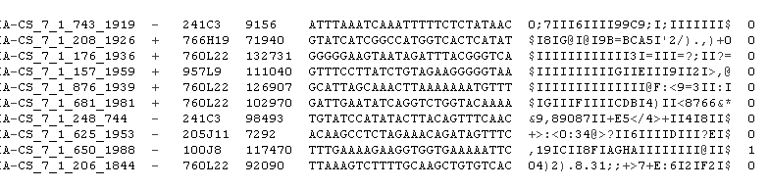
Alignment to a reference genome: example of short-read alignment (Bowtie) results
References to which
reads match
reads
quality scores

Slide 64
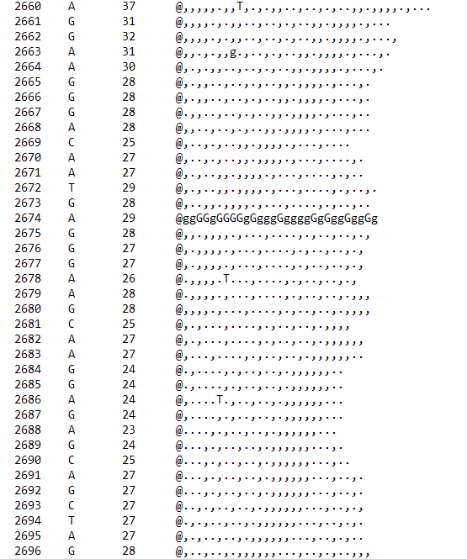
Reference sequence
(5 Mb, fasta format)
Read depth
Reference sequence A;
Sample has G 29 times
. and , denote agreement with reference on top, bottom strands
MAQ analysis

Slide 65
BWA: a popular short-read aligner
Aligns short reads (<200 base pairs) to a reference genome
Fast, accurate
Learn more at http://bio-bwa.sourceforge.net/
Command-line software for the Linux environment (like essentially all NGS tools)
Try it in a web-accessible version! Go to Galaxy > see list of tools on left sidebar > NGS Toolbox beta > NGS: Mapping > Map with BWA for Illumina
Notes:
65

Slide 66
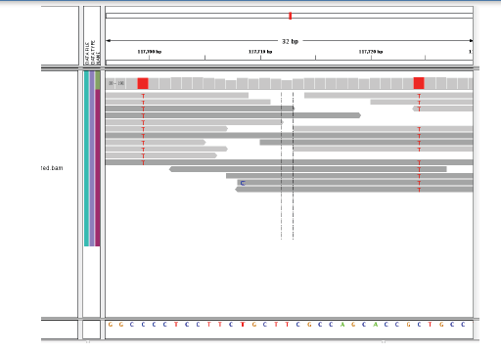
Next-generation sequence data: visualizing of short reads aligned to a reference genome
reads
variant
reference genome

Slide 67
Reads (FASTQ format) can be mapped to a reference genome using software tools such as BWA
There are dozens of aligners to choose from.
Each aligner has many parameters you can choose.
BWA is a popular aligner. It stands for “Burroughs-Wheeler Aligner” referring to the algorithmic approach. See http://bio-bwa.sourceforge.net

Slide 68
Reads (FASTQ format) can be mapped to a reference genome using software tools such as BWA (cont.)
Considerations are speed and sensitivity.
For all software we measure error rates: using some gold standard we define true positive (TP) and true negative (TN) results, and we then define sensitivity and specificity.
A standard format has been introduced called Sequence Alignment/Map (SAM). Its binary version (which is compressed) is called BAM.
Google SAM/BAM for specifications & more information.

Slide 69
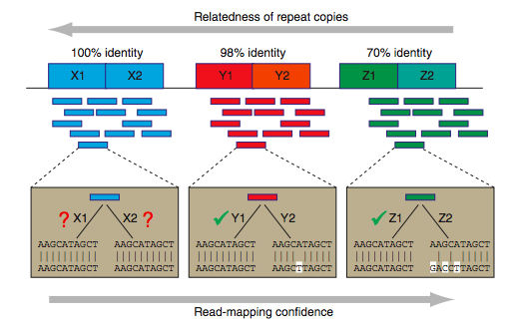
As repeat regions share lower identity,
read mapping gains higher confidence
Relatedness of repeat copies
B&FG 3e
Fig.9-12
Page 401
Read mapping confidence
Source: PMID 22124482

Slide 70
There is ambiguity mapping a read with a mismatch versus a deletion
B&FG 3e
Fig.9-12
Page 401
Source: PMID xxxxxxxx

Slide 71
Outline:
Analysis of Next-Generation Sequence (NGS) Data
Introduction
DNA sequencing technologies
Sanger sequencing; NGS; Illumina; pyrosequencing; ABI SOLiD; Ion Torrent; Pac Bio; Complete Genomics
Analysis of NGS sequencing of genomic DNA
Overview Topic 6: Variant calling: SNVs
Topic 1: Design Topic 7: Variant calling: SVs
Topic 2: FASTQ Topic 8: VCF
Topic 3: Assembly Topic 9: Visualizing NGS data
Topic 4: Alignment Topic 10: Significance
Topic 5: SAM/BAM
Specialized applications of NGS
Perspective

Slide 72
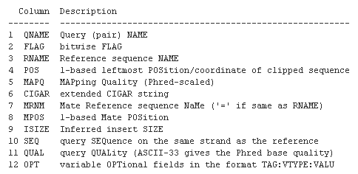
BWA and other aligners produce output in the SAM format

Slide 73
Sequence alignment/map format (SAM) and BAM
SAM is a common format having sequence reads and their alignment to a reference genome.
BAM is the binary form of a SAM file.
Aligned BAM files are available at repositories (Sequence Read Archive at NCBI, ENA at Ensembl)
SAMTools is a software package commonly used to analyze SAM/BAM files.
Visit http://samtools.sourceforge.net/
Notes:
73

Slide 74
Anatomy of a Sequence Alignment/Map (SAM) file
B&FG 3e
Fig.9-13
Page 403

Slide 75
Anatomy of a Sequence Alignment/Map (SAM) file
In this example we’ll look at a file called 030c_s7.bam. It is a BAM file (the binary of a SAM). Most software manipulates BAM files rather than SAM.
The $ symbol indicates a command prompt in Unix
The | symbol (called “pipe”) indicates to send the results to another program—in this case to the utility called less that displays one page at a time on your terminal.
Type samtools to run that program, and it includes a series of tools (such as view) to accomplish particular tasks—here, to view the contents of a file
B&FG 3e
Fig.9-13
Page 403

Slide 76
SAMTools tview visualization of reads from a BAM file
There are many tools to view SAM/BAM files. A popular software package (SAMTools, used in Linux) includes tview visualization of reads from a BAM file
B&FG 3e
Fig.9-14
Page 404

Slide 77
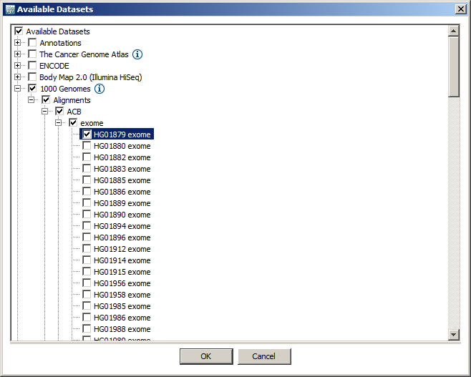
IGV visualization of reads from a BAM file
Step (1): open IGV (Mac or PC) from its website
Step (2): File > Load from server > load one exome

Slide 78
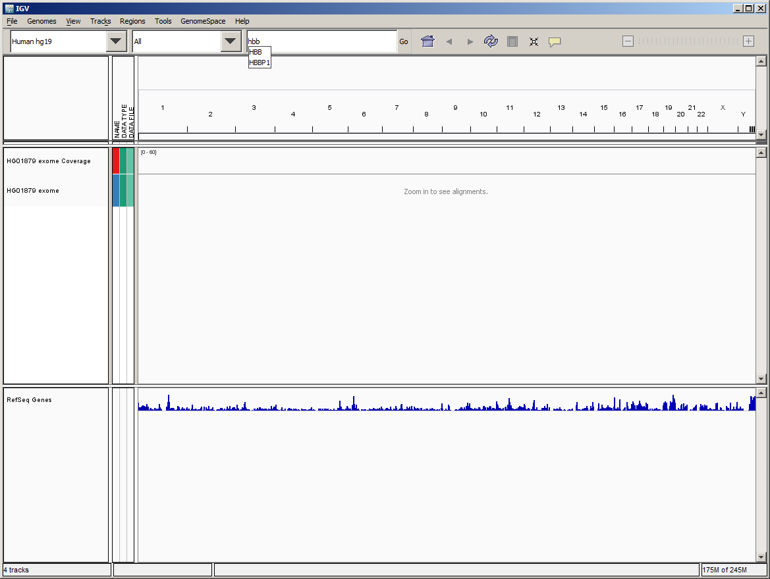
IGV visualization of reads from a BAM file
Step (3): enter a gene symbol (HBB) into the search box.

Slide 79
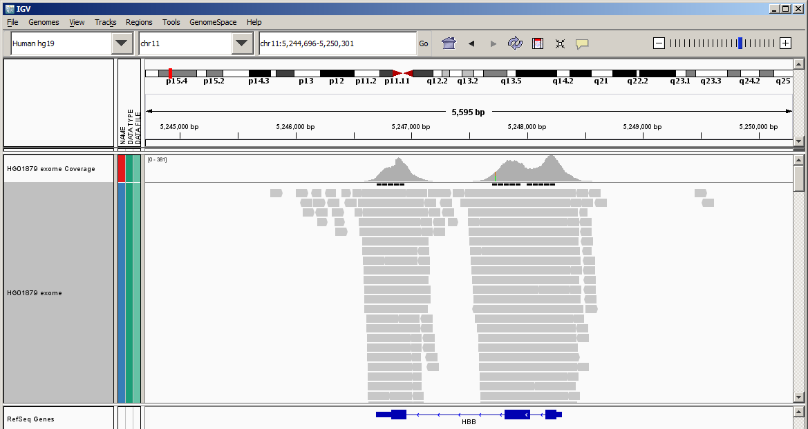
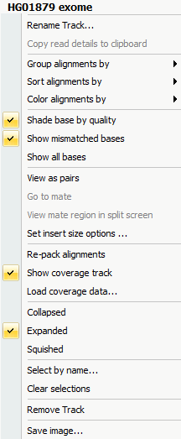
IGV visualization of reads from a BAM file
Step (4): explore this gene. Zoom in. Click the left sidebar to change the display to squished. Color the alignments. Find variants.

Slide 80
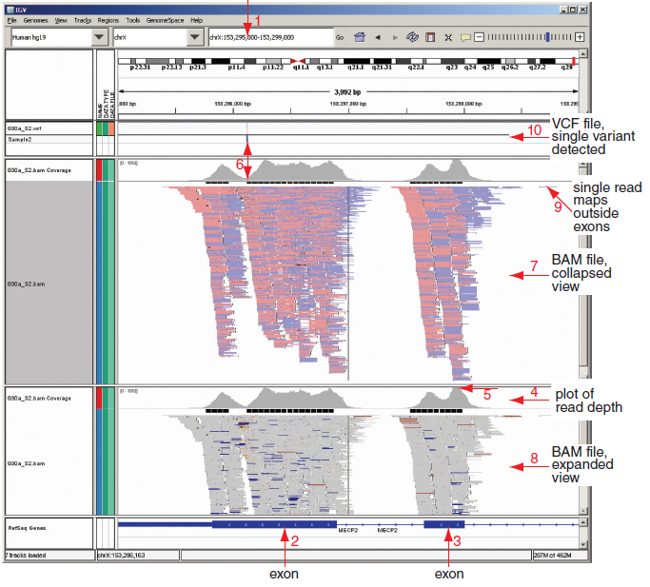
Integrative Genomics Viewer (IGV):
display of a BAM file (at two resolutions) and a VCF
B&FG 3e
Fig.9-15
Page 407

Slide 81
Outline:
Analysis of Next-Generation Sequence (NGS) Data
Introduction
DNA sequencing technologies
Sanger sequencing; NGS; Illumina; pyrosequencing; ABI SOLiD; Ion Torrent; Pac Bio; Complete Genomics
Analysis of NGS sequencing of genomic DNA
Overview Topic 6: Variant calling: SNVs
Topic 1: Design Topic 7: Variant calling: SVs
Topic 2: FASTQ Topic 8: VCF
Topic 3: Assembly Topic 9: Visualizing NGS data
Topic 4: Alignment Topic 10: Significance
Topic 5: SAM/BAM
Specialized applications of NGS
Perspective

Slide 82
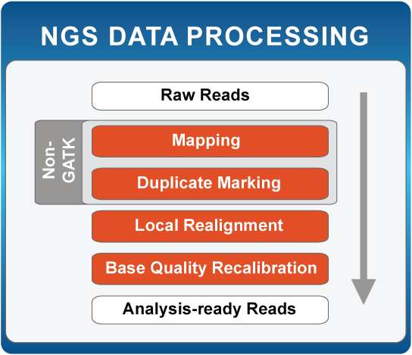
Genotyping with Genome Analysis Toolkit (GATK)
Popular suite of tools used for genotyping and variant discovery
http://www.broadinstitute.org/gatk/
Notes:
82

Slide 83
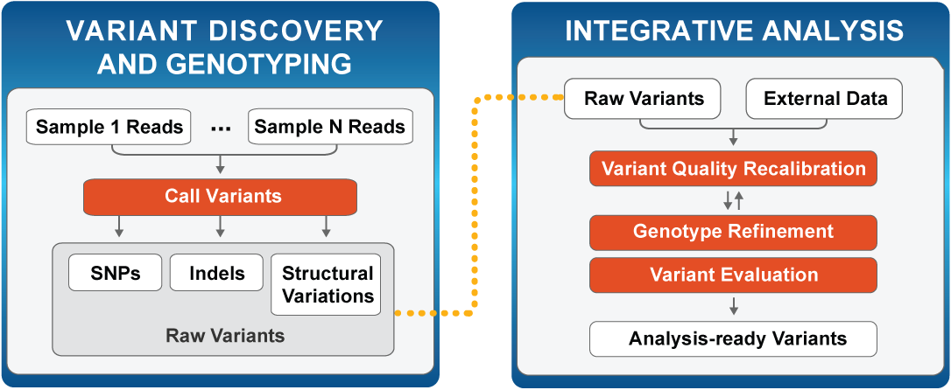
Genotyping with Genome Analysis Toolkit (GATK)
http://www.broadinstitute.org/gatk/
Notes:
83

Slide 84
Outline:
Analysis of Next-Generation Sequence (NGS) Data
Introduction
DNA sequencing technologies
Sanger sequencing; NGS; Illumina; pyrosequencing; ABI SOLiD; Ion Torrent; Pac Bio; Complete Genomics
Analysis of NGS sequencing of genomic DNA
Overview Topic 6: Variant calling: SNVs
Topic 1: Design Topic 7: Variant calling: SVs
Topic 2: FASTQ Topic 8: VCF
Topic 3: Assembly Topic 9: Visualizing NGS data
Topic 4: Alignment Topic 10: Significance
Topic 5: SAM/BAM
Specialized applications of NGS
Perspective

Slide 85
Categories of structural variation (SV)
Read depth
SV class
Assembly
Read pair
Split end
Deletion
Novel sequence insertion
Mobile-element insertion
Inversion
Interspersed duplication
B&FG 3e
Fig.9-16
Page 409
Tandem duplication
Source: PMID 21358748

Slide 86
Categories of structural variation (SV): deletions
Read depth
SV class
Assembly
Read pair
Split end
Deletion
B&FG 3e
Fig.9-16
Page 409
Source: PMID 21358748

Slide 87
Categories of structural variation (SV): insertions
Read depth
SV class
Assembly
Read pair
Split end
Novel sequence insertion
not applicable
Mobile-element insertion
not applicable
B&FG 3e
Fig.9-16
Page 409
Source: PMID 21358748

Slide 88
Categories of structural variation (SV): inversions
Read depth
SV class
Assembly
Read pair
Split end
Inversion
not applicable
B&FG 3e
Fig.9-16
Page 409
Source: PMID 21358748

Slide 89
Categories of structural variation (SV): duplications
Read depth
SV class
Assembly
Read pair
Split end
Interspersed duplication
Tandem duplication
B&FG 3e
Fig.9-16
Page 409
Source: PMID 21358748

Slide 90
Outline:
Analysis of Next-Generation Sequence (NGS) Data
Introduction
DNA sequencing technologies
Sanger sequencing; NGS; Illumina; pyrosequencing; ABI SOLiD; Ion Torrent; Pac Bio; Complete Genomics
Analysis of NGS sequencing of genomic DNA
Overview Topic 6: Variant calling: SNVs
Topic 1: Design Topic 7: Variant calling: SVs
Topic 2: FASTQ Topic 8: VCF
Topic 3: Assembly Topic 9: Visualizing NGS data
Topic 4: Alignment Topic 10: Significance
Topic 5: SAM/BAM
Specialized applications of NGS
Perspective

Slide 91
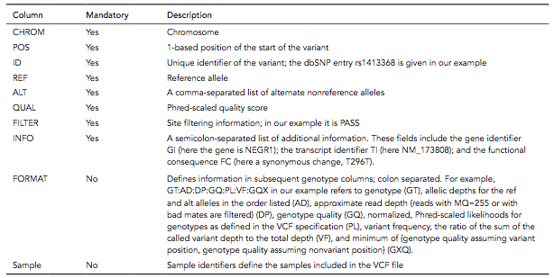
Variant Call Format (VCF) file summarizes variation
A VCF file includes the following information:
B&FG 3e
Table 9.6
Page 411

Slide 92
Variant Call Format (VCF) file summarizes variation
A VCF file includes the following information:
A typical VCF file from a human whole exome sequence experiment may contain ~80,000 rows. A typical human whole genome sequence experiment produces a VCF with ~4 million rows.
B&FG 3e
Table 9.6
Page 411

Slide 93
Variant Call Format (VCF) file summarizes variation
VCF header
B&FG 3e
Fig.9-17
Page 412

Slide 94
Variant Call Format (VCF) file summarizes variation
VCF field definition line and first row of body
Fields include chromosome (CHROM), position, identifier (e.g. rsID), reference allele, alternate allele, quality score, and extensive data (e.g. haplotypes, read depth, quality scores, functional consequences, accession numbers)
B&FG 3e
Fig.9-17
Page 412

Slide 95
Variant Call Format (VCF) file summarizes variation
SNP
Insertion
Deletion
Replacement
Large structural variant
B&FG 3e
Fig.9-17
Page 412

Slide 96
Outline:
Analysis of Next-Generation Sequence (NGS) Data
Introduction
DNA sequencing technologies
Sanger sequencing; NGS; Illumina; pyrosequencing; ABI SOLiD; Ion Torrent; Pac Bio; Complete Genomics
Analysis of NGS sequencing of genomic DNA
Overview Topic 6: Variant calling: SNVs
Topic 1: Design Topic 7: Variant calling: SVs
Topic 2: FASTQ Topic 8: VCF
Topic 3: Assembly Topic 9: Visualizing NGS data
Topic 4: Alignment Topic 10: Significance
Topic 5: SAM/BAM
Specialized applications of NGS
Perspective

Slide 97
Visualizing and tabulating next-generation sequence data
There are many ways to visualize BAM files.
Try Genome Workbench from NCBI
Upload your BAM file to a server and point to it using the UCSC Genome Browser
Use Integrative Genomics Viewer (IGV)
Use samtools tview
We will next explore BEDtools, a set of programs used to analyze BAM, GTF, BED, VCF, and other file types.
B&FG 3e
Page 413

Slide 98
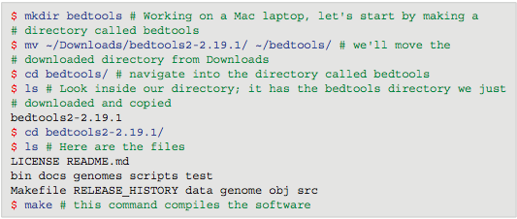
BEDtools to explore genomics data
Download and install bedtools:
Place the executables in your path:
B&FG 3e
Page 414

Slide 99
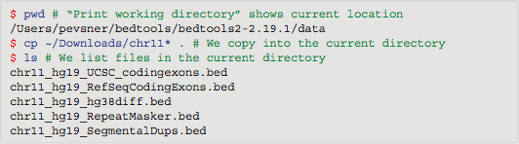
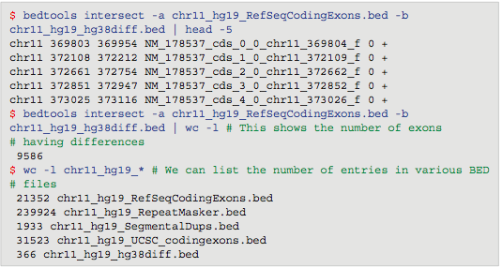
BEDtools to explore genomics data
Obtain some BED files. For example, visit the UCSC Table Browser and output any BED files of interest.
B&FG 3e
Page 414

Slide 100
BEDtools example 1: What RefSeq coding exons differ between GRCh37 and GRCh38?
Use BEDtools intersect. General format of a query:
Our query:
B&FG 3e
Page 415

Slide 101
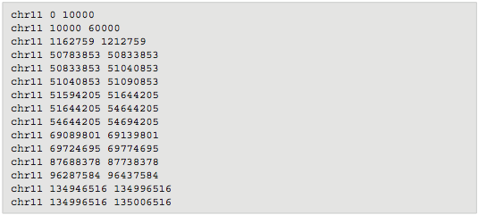
BEDtools example 2: What is the closest chromosomal gap to every RefSeq exon?
Here is a BED file of all gaps on chromosome 11:
Each chromosome has gaps at the telomeres, at the centromere, and at other locations that have been too challenging to sequence.
B&FG 3e
Page 415

Slide 102
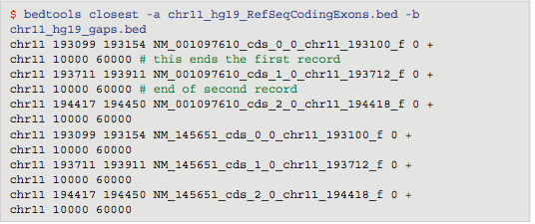
BEDtools example 2: What is the closest chromosomal gap to every RefSeq exon?
We use the bedtools closest utility. Here are the results:
B&FG 3e
Page 416

Slide 103
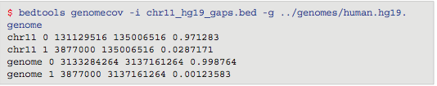
BEDtools example 3: How much of a chromosome (or a genome) is spanned by gaps?
We use the genomecov (genome coverage) utility, and use the -g argument to specify a genome. Here are the results:
2.87% of the chromosome (0.0287), and 0.1% of the genome is spanned by gaps.
B&FG 3e
Page 416

Slide 104
Outline:
Analysis of Next-Generation Sequence (NGS) Data
Introduction
DNA sequencing technologies
Sanger sequencing; NGS; Illumina; pyrosequencing; ABI SOLiD; Ion Torrent; Pac Bio; Complete Genomics
Analysis of NGS sequencing of genomic DNA
Overview Topic 6: Variant calling: SNVs
Topic 1: Design Topic 7: Variant calling: SVs
Topic 2: FASTQ Topic 8: VCF
Topic 3: Assembly Topic 9: Visualizing NGS data
Topic 4: Alignment Topic 10: Significance
Topic 5: SAM/BAM
Specialized applications of NGS
Perspective

Slide 105
Prioritizing variants and assessing functional significance
This section is organized in two parts.
We will look at software that is used to assess which variants are functionally significant. Over 50 programs have been introduced. We will mention three: SIFT, PolyPhen, and VAAST.
NCBI offers databases, browsers and software tools to understand functionally important variants. We will introduce four NCBI resources.
B&FG 3e
Page 417

Slide 106
Neutral versus deleterious variation
For each genome, we can expect to identify ~4 million variants that are exonic, intronic, or intergenic. We first focus on exonic variants. Of these, there are ~11,000 synonymous SNPs (not changing the amino acid specified by the codon; likely to be benign) and ~11,000 nonsynonymous SNPs.
We also consider indels (some of which introduce stop codons), homozygous deletions, splice site mutations, or other changes that may disrupt gene function.

Slide 107
Approaches to distinguish neutral from deleterious nonsynonymous variants
Most DNA is under neutral selection (not under positive or negative selection). Some variants are deleterious. How can we classify 11,000 nonsynonymous SNPs in a genome?
--Conservation: determine conservation of an amino acid across species
--Structure: determine (or predict) effect of a variant on protein structure
--True positives: train algorithms on a database of known disease-associated mutations (OMIM)
--True negatives: train algorithms of a set of variants in ‘apparently normal’ individuals (1000 Genomes)

Slide 108
Software to distinguish neutral from deleterious nonsynonymous variants
PolyPhen2 (Polymorphism Phenotyping v2) is a tool which predicts possible impact of an amino acid substitution on the structure and function of a human protein using straightforward physical and comparative considerations.
http://genetics.bwh.harvard.edu/pph2/
SIFT predicts whether an amino acid substitution affects protein function based on sequence homology and the physical properties of amino acids.
http://sift.jcvi.org/

Slide 109



Example: SIFT and Polyphen scores for HBB
[1] Visit http://www.ensembl.org/human
[2] Enter hbb in the search box
[3] Follow the link to the gene

Slide 110

Ensembl “Variation Table” for HBB shows SIFT and PolyPhen scores for nonsynonymous variants (note they disagree)

Slide 111
VAAST: probabilistic tool for disease variants
VAAST (Variant Annotation, Analysis & Search Tool) is a probabilistic search tool used to identify disease-causing variants.
VAAST calculates amino acid substitution frequencies for healthy genomes and disease genomes (both of these differ from standard BLOSUM62).

Slide 112

NCBI tools to understand variation
From the home page of NCBI choose Variation

Slide 113

NCBI tools to understand variation
Explore Variation databases, tools, guides

Slide 114

NCBI tools to understand variation: (1) PheGenI
http://www.ncbi.nlm.nih.gov/gap/phegeni
Phenotype-Genotype Integrator: enter a disease, trait, gene (or list of gene symbols, location). Search!

Slide 115

NCBI tools to understand variation: (1) PheGenI
PheGenI output: list of implicated genes, SNPs, association results, more.

Slide 116

NCBI tools to understand variation: (2) ClinVar
http://www.ncbi.nlm.nih.gov/clinvar/
ClinVar: “A resource to provide a public, tracked record of reported relationships between human variation and observed health status with supporting evidence. Related information in the NIH Genetic Testing Registry (GTR), MedGen, Gene, OMIM, PubMed and other sources is accessible through hyperlinks on the records.”

Slide 117

NCBI tools to understand variation: (2) ClinVar
ClinVar: result for “hbb”

Slide 118

NCBI tools to understand variation: (2) ClinVar
ClinVar: use facets to limit results (here pathogenic, missense, multiple submitters)

Slide 119

NCBI tools to understand variation: (2) ClinVar
ClinVar: details of mutant alleles
review status
interpretation, phenotype
Type of allele, location
Link to Variation Viewer
http://www.ncbi.nlm.nih.gov/clinvar/variation/15234/

Slide 120


NCBI tools to understand variation: (3) Variation Reporter
Variation Reporter: enter a VCF or other file(s) such as BED, HGVS, GVF. Click Done then Submit!
http://www.ncbi.nlm.nih.gov/variation/tools/reporter

Slide 121

NCBI tools to understand variation: (4) Variation Viewer
http://www.ncbi.nlm.nih.gov/variation/view/
Variation Viewer: “A genomic browser to search and view genomic variations listed in dbSNP, dbVar, and ClinVar databases. Searches can be performed using chromosomal location, gene symbol, phenotype, or variant IDs from dbSNP and dbVar. The browser enables exploration of results in a dynamic graphical sequence viewer with annotated tables of variations.”

Slide 122


NCBI tools to understand variation: (4) Variation Viewer
Variation Viewer: vast options in tools and tracks (the gear icon)

Slide 123

NCBI tools to understand variation: (4) Variation Viewer
Variation Viewer:
note extensive
faceted searches

Slide 124
Outline:
Analysis of Next-Generation Sequence (NGS) Data
Introduction
DNA sequencing technologies
Sanger sequencing; NGS; Illumina; pyrosequencing; ABI SOLiD; Ion Torrent; Pac Bio; Complete Genomics
Analysis of NGS sequencing of genomic DNA
Overview Topic 6: Variant calling: SNVs
Topic 1: Design Topic 7: Variant calling: SVs
Topic 2: FASTQ Topic 8: VCF
Topic 3: Assembly Topic 9: Visualizing NGS data
Topic 4: Alignment Topic 10: Significance
Topic 5: SAM/BAM
Specialized applications of NGS
Perspective

Slide 125
Specialized next-generation sequence (NGS) applications
There are many useful applications of NGS technology. These include:
RNA-seq (Chapter 11) to measure RNA levels (“gene expression” of genes and isoforms)
Chromatin immunoprecipitation sequencing (ChIP-Seq) to measure protein– DNA interactions
Methyl-seq
FAIRE-seq
many others
B&FG 3e
Page 421

Slide 126
Outline:
Analysis of Next-Generation Sequence (NGS) Data
Introduction
DNA sequencing technologies
Sanger sequencing; NGS; Illumina; pyrosequencing; ABI SOLiD; Ion Torrent; Pac Bio; Complete Genomics
Analysis of NGS sequencing of genomic DNA
Overview Topic 6: Variant calling: SNVs
Topic 1: Design Topic 7: Variant calling: SVs
Topic 2: FASTQ Topic 8: VCF
Topic 3: Assembly Topic 9: Visualizing NGS data
Topic 4: Alignment Topic 10: Significance
Topic 5: SAM/BAM
Specialized applications of NGS
Perspective

Slide 127
Perspective
Next-generation sequencing (NGS) technology is revolutionizing biology. We are now able to catalog genetic variation at unprecedented depth.
There is rapid growth in the technologies used for NGS. There are also vast numbers of software solutions for quality control, sequence alignment, genome assembly, variant calling (including single nucleotide variants, indels, and structural variants), and variant prioritization.
Key file formats include FASTQ (“raw” reads), BAM/SAM (aligned reads), and VCF (variant calls). Many tools are available for the generation, analysis, and visualization of these types of files.

